Slide 1
Foundations of Relationship-Based Early Intervention – Online Training Overview
Andy Gomm
Michelle Staley
Notes:
Andy
Welcome to today’s webinar. We are introducing you to the NEW Foundations of Relationship-Based Early Intervention Online Course and support you as Directors, Coordinators and Leads to recognize the important role you will play in supporting providers within your agency to understand the relationship and routines-based nature of the work in the NM FIT Program.

Slide 2
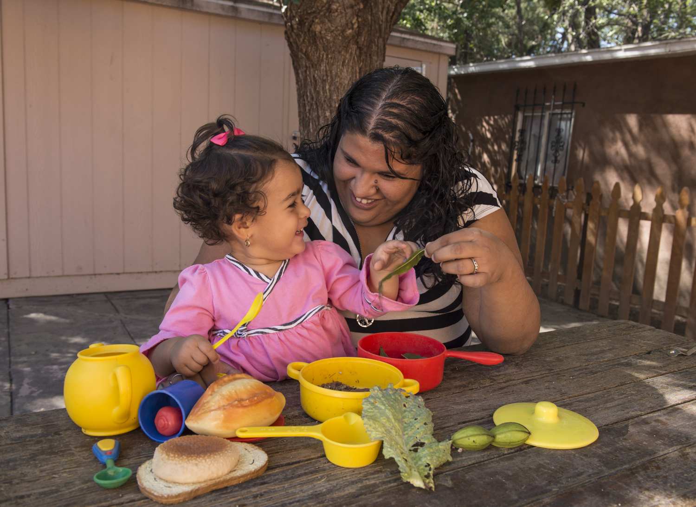
Agenda
Background
Overview of the web-based course
Role of the manager and mentor in supporting the learner
Tracking participation and validating of certificates
Support from FIT and ECN
Notes:
Andy
Background
Overview of the web-based course
Role of the manager and mentor in supporting the learner
Tracking participation and validating of certificates
Support from FIT and ECN

Slide 3
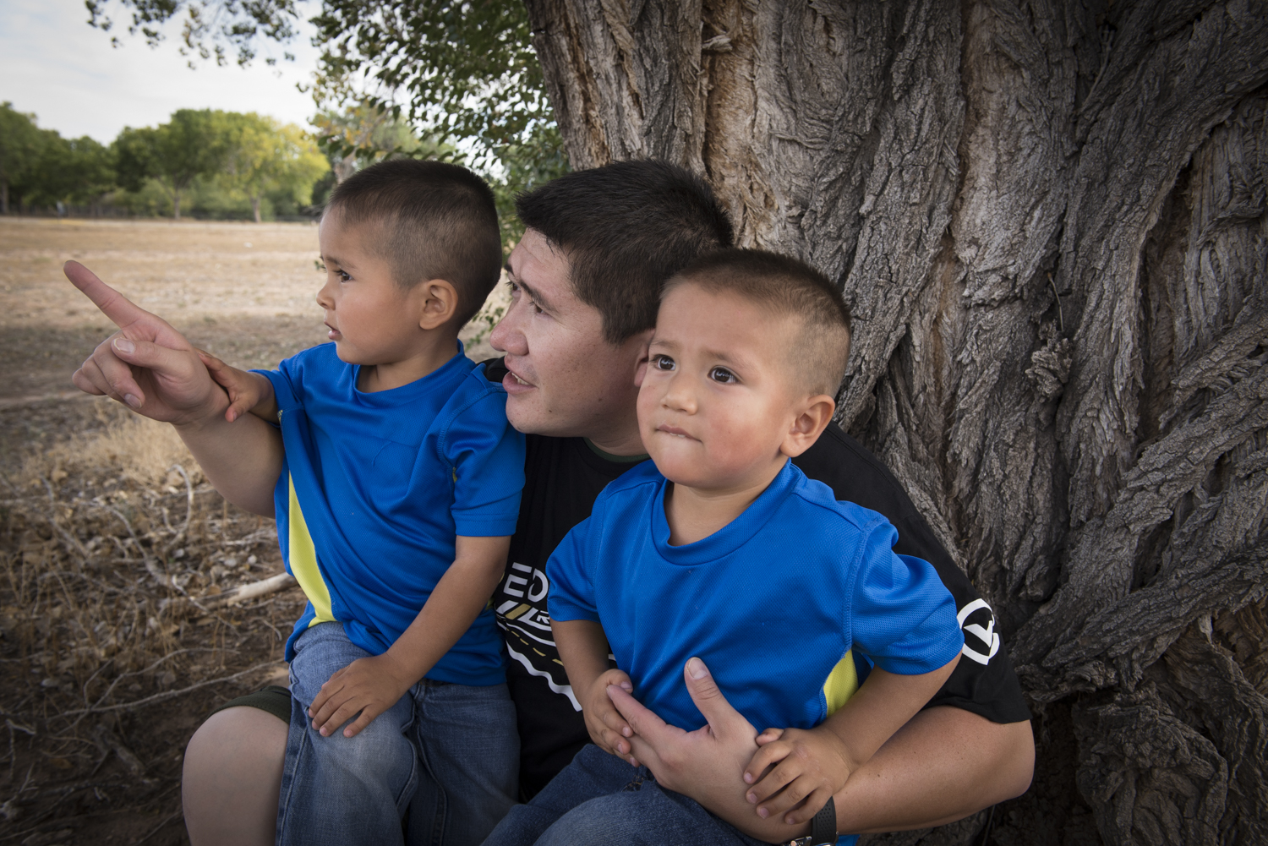
Background
Notes:
Andy
Most of you will be familiar with the FIT Core Trainings – Family Visiting and It’s Only Natural. These two trainings were offered in-person, over the course of two days and provided an introduction to the nature of the work of early intervention. However, for many agencies, this also required travel and overnight stays for staff. Over the past 2 years, the FIT Program has begun to look more closely at Quality Elements of Practice and how to support provider agencies in learning and implementing evidence-based practices. This NEW online training is a re-packing of the previous two-day, in-person training: it is still an introduction to the work of early intervention but with additional emphasis on the NM Key Principles and what these look like in the work.

Slide 4

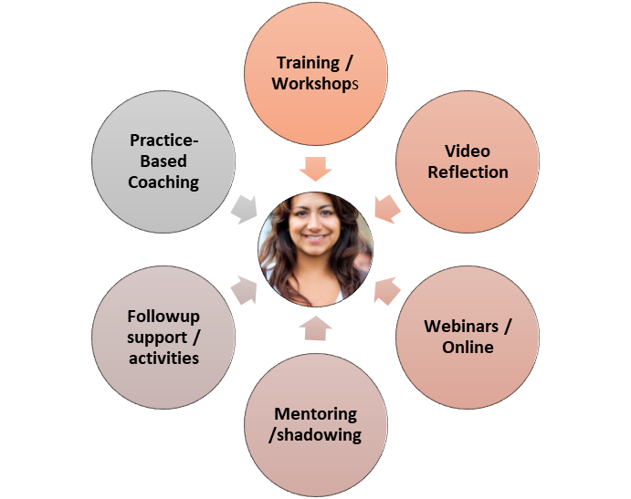
Paradigm shift from training to professional development
This will take a partnership between FIT providers, ECN and the FIT team over the months ahead…
Notes:
Andy
For those of you who have viewed the Professional Development Leadership Team webinar, this slide will be familiar. Here, we want to emphasize the shift that we are making by moving away from “trainings” and moving into a more comprehensive system of professional development. The new Foundations of Relationship-Based Early Intervention is an (CLICK) online course, with activities requiring (CLICK) follow up support. This is the first professional development activity that has been revised for our new system. We want to assure you that all of these efforts are to create a professional development partnership between FIT providers, ECN and the FIT team and that resources will be available to provider agencies to assist with this shift.

Slide 5

This training will provide a foundation for the participant to recognize how their relationship with families, along with evidence-based practices, and adult learning concepts support building the capacity of the family to promote learning opportunities for their child throughout the day.
Purpose
Notes:
Andy
This slide, from the actual course itself, will assist you in understanding the overall purpose of the training:
Participants will understand how trusting relationships, regulations, research, key principles and learning concepts provide the foundation for effective early intervention practices and recognize the caregiver’s confidence and competence increases when children’s learning is supported in the context of routines important to the family.

Slide 6
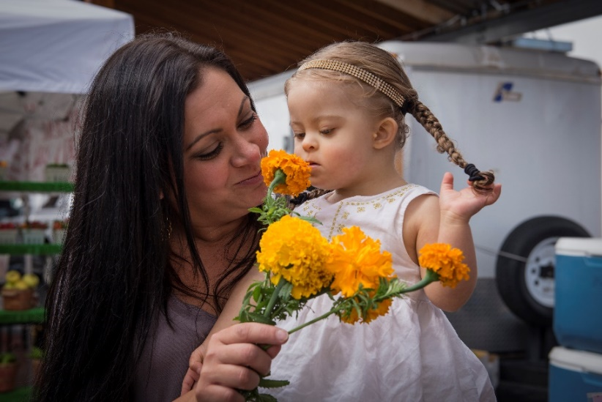
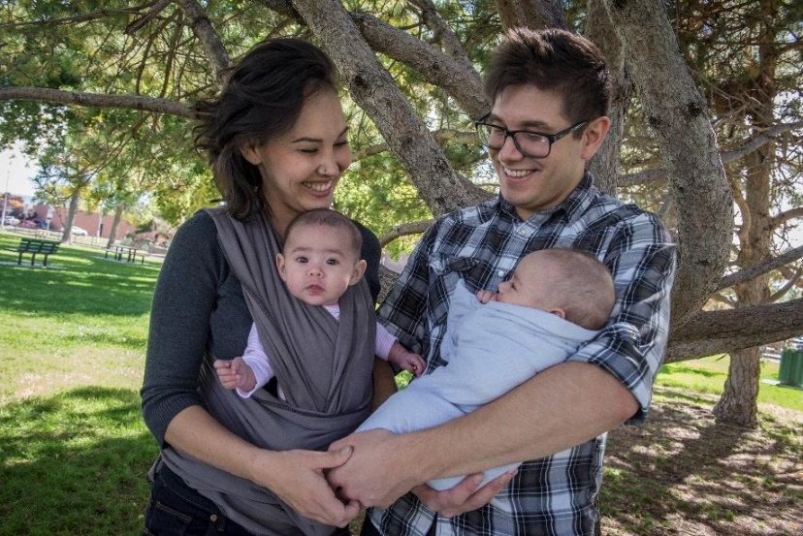
It is important to know this course...
Replaces two trainings:
  Family Visiting
  It’s Only Natural
Is required for Developmental Specialists with an Exemption in the NM FIT Program
Acts as the pre-requisite for the EI Practices Using FGRBEI training (Coming Soon!)
Recommended for all practitioners, Family Service Coordinators within first few weeks of hire!
Notes:
Andy
In addition to replacing two trainings:
Family Visiting
It’s Only Natural
Is required for Developmental Specialists with an Exemption in the NM FIT Program.
Acts as the pre-requisite for the EI Practices Using FGRBEI training (Coming Soon!)
Recommended for all practitioners, Family Service Coordinators within first few weeks of hire!

Slide 7
This course will also…
Provide ALL practitioners and Family Service Coordinators (FSCs) with a foundational understanding of the FIT Key Principles for early intervention
Support practitioners to gain an understanding of the relationship and routines-based nature of the work in the NM FIT Program
Provide beneficial information to support ALL disciplines with key concepts for developing relationships in a home or community setting
Result in rethinking the concept of routines as the foundation for intervention
Notes:
Andy
Provide ALL practitioners and Family Service Coordinators (FSCs) with a foundational understanding of the FIT Key Principles for early intervention
Support practitioners to gain an understanding of the relationship and routines-based nature of the work in the NM FIT Program
Provide beneficial information to support ALL disciplines with key concepts for developing relationships in a home or community setting
Result in rethinking the concept of routines as the foundation for intervention

Slide 8

There are Seven Lessons
What Guides the Work We Do?
Adult Learning
Relationships
Observation
Family Diversity and Uniqueness
Toddlers Learn within Routines and Everyday Activities
Exploring Routines
Notes:
Michelle
The module is broken into seven (7) smaller lessons to allow more flexibility for the learner to complete at her or his own pace and to allow greater ease of access over the internet. The seven lessons include
What Guides the Work We Do?
Adult Learning
Relationships
Observation
Family Diversity and Uniqueness
Toddlers Learn within Routines and Everyday Activities
Exploring Routines
Although an approximation, each session will range between 20 and 30 minutes, including completion of the activities.

Slide 9
Learning Objectives
Explore using inquiry in our work with families to help the practitioner recognize the diversity, uniqueness, and strength of families.
Explore and reflect on how intervention within the context of routines can build caregiver competence and confidence.
Gain an understanding of how regulation, research, evidence-based practices, and key principles provide the foundation for effective early intervention practices.
Identify and reflect on the characteristics and components that build and support trusting relationships with families including both personal and professional boundaries.
Explore the nature of observation and recognize how being objective in our observations will support caregivers and families.
Identify and recognize how routines can build caregiver competence and confidence and embed learning opportunities for their child throughout the day.
Begin to recognize when we use adult learning concepts the family feels confident and competent in supporting their child’s development in routines and activities important to their family.
Notes:
Michelle
Each of the seven lessons connects to one of the seven learning objectives seen here:
Gain an understanding of how regulation, research, evidence based practices, and key principles provide the foundation for effective early intervention practices.
Begin to recognize when we use adult learning concepts the family feels confident and competent in supporting their child in routines and activities important to their family.
Identify and reflect on the characteristics and components that build and support trusting relationships with families including both personal and professional boundaries.
Explore the nature of observation and recognize how being objective in our observations will support caregivers and families.
Explore using inquiry in our work with families to help the practitioner recognize the diversity, uniqueness, and strength of families.
Explore and reflect on how intervention within the context of routines can build caregiver competence and confidence.
Identify and recognize how routines can build caregiver competence and confidence and embed learning opportunities for their child throughout the day.

Slide 10
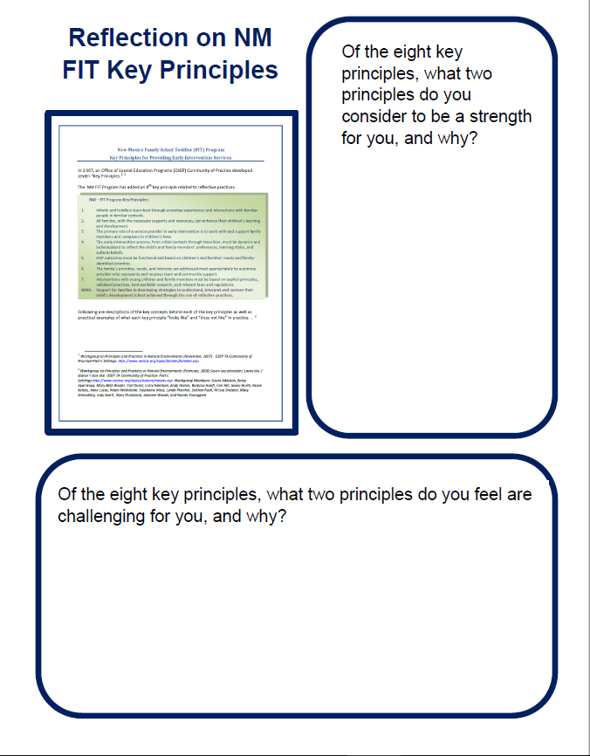
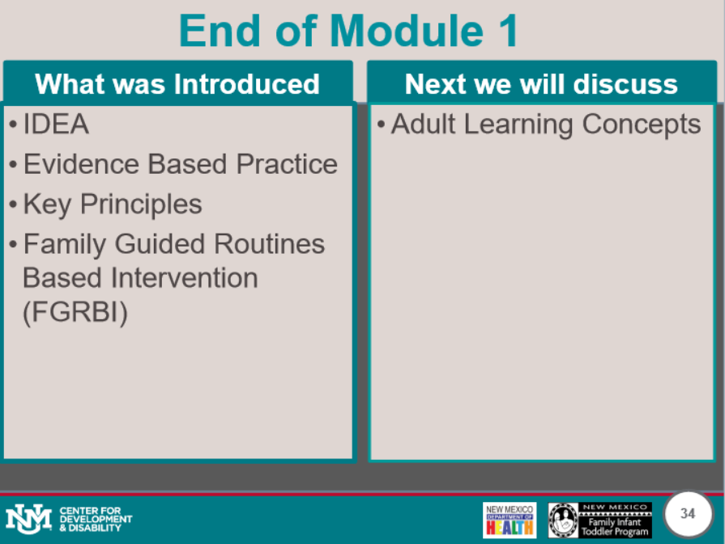

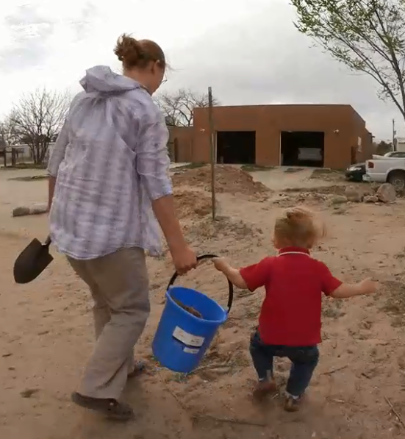
Structure of Each Lesson
Notes:
Michelle
Every lesson is designed to support the adult learning process by providing the following:
an activity;
a quiz; and
A summary of what was covered in the lesson and what will be introduced in the next lesson.
In addition we utilized several videos of New Mexico FIT Practitioners and families.

Slide 11
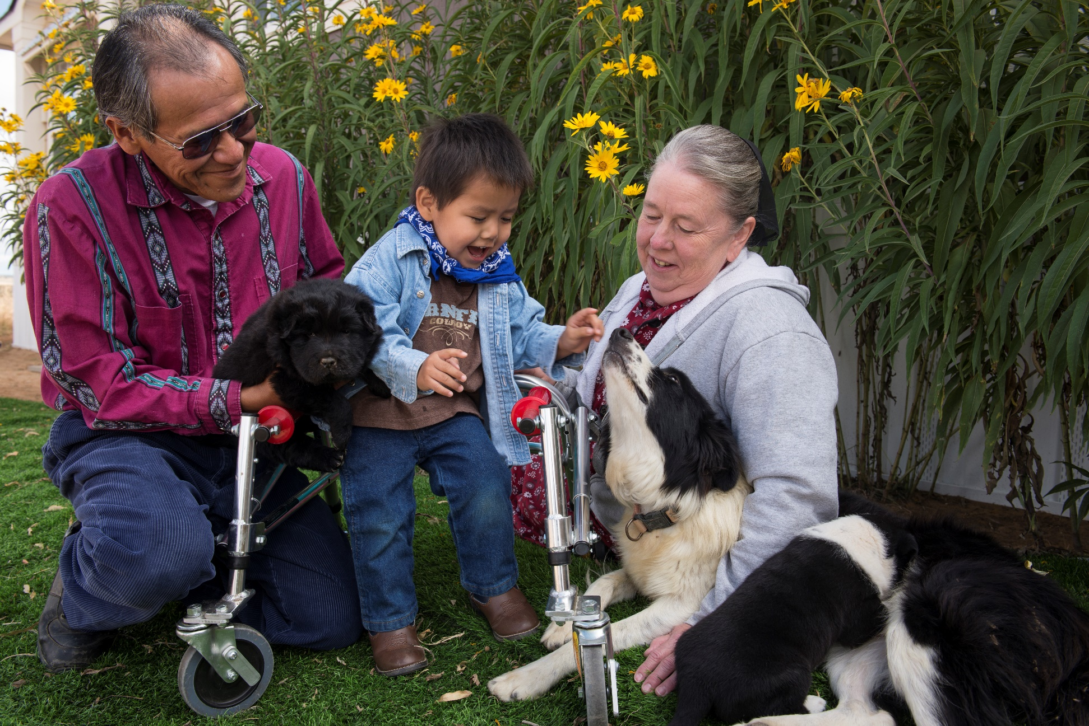
Accessibility
Through the use of Articulate software this training includes closed captioning for all videos.
The course contains both audio and written narration.
Compatible with accessibility technology.
Notes:
Michelle
We recently purchased new software resulting in this course having additional accessibility features, including the close captioning of all videos. In addition, the course contains both audio and written narration. The audio contained in the course is narrated in the notes section. Accessibility technology is also supported in the course.

Slide 12

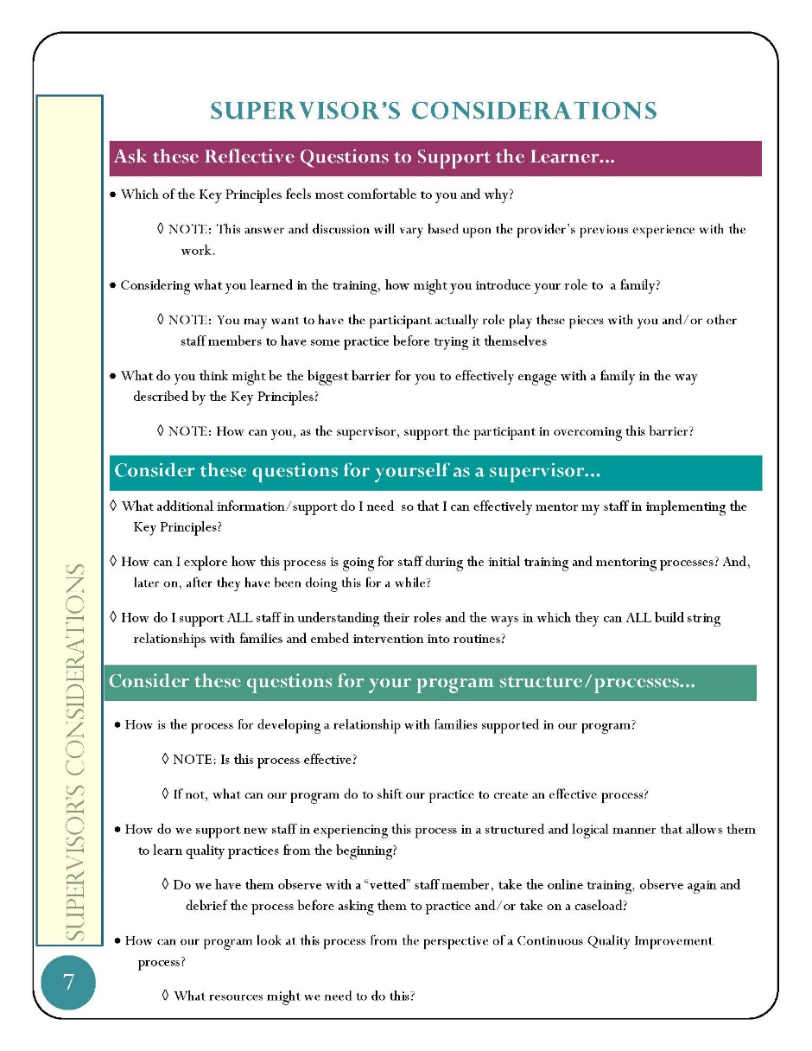
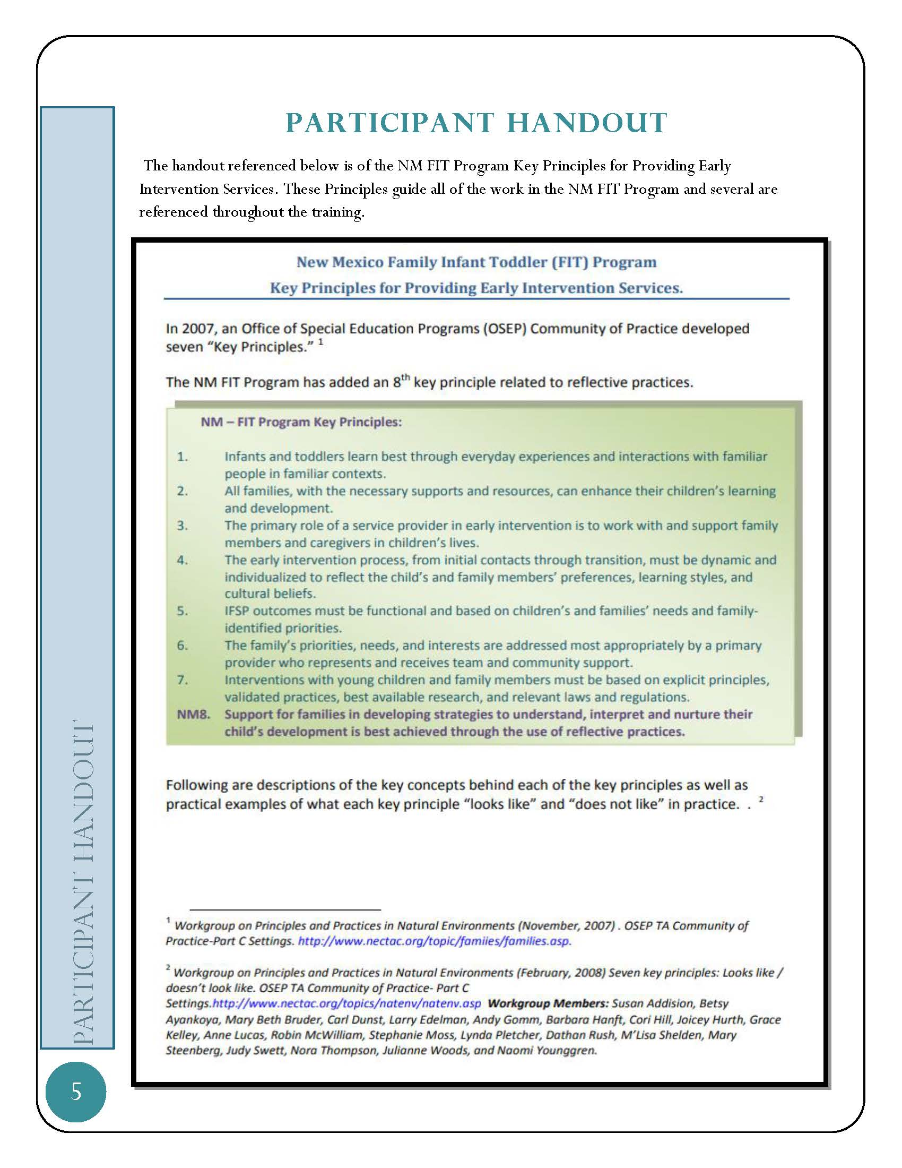

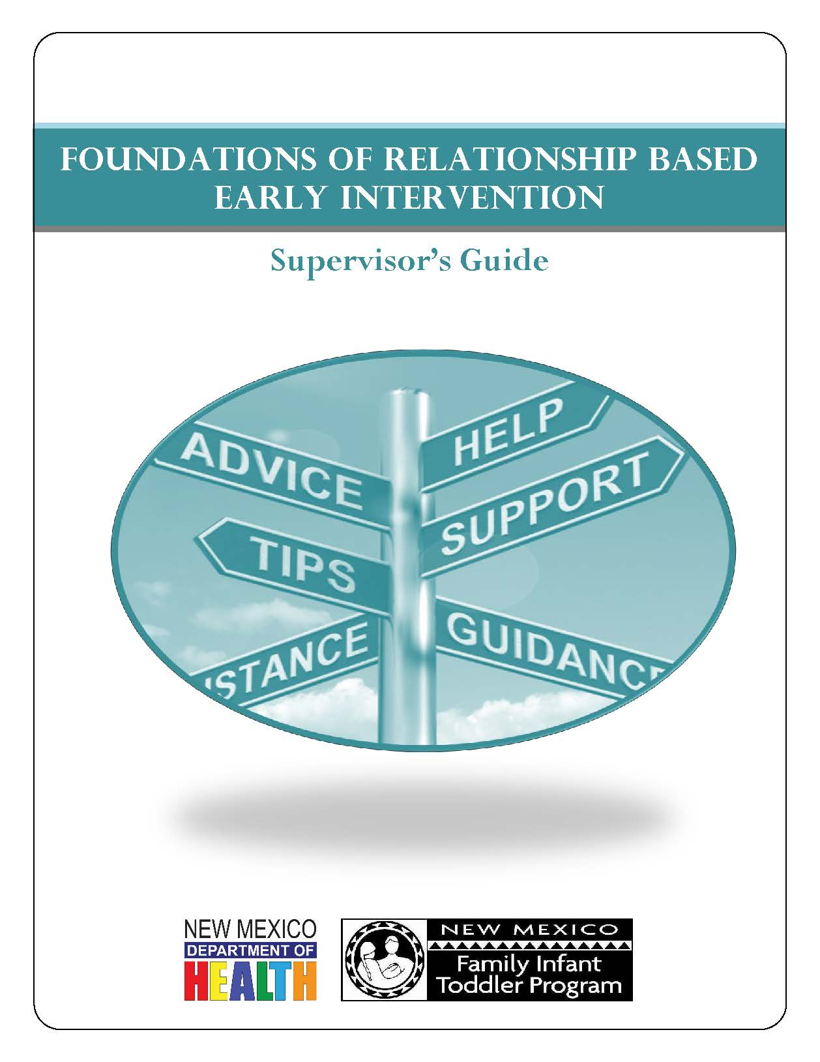
Role of manager, mentors and leads!
Notes:
Andy
In the previous slide we mentioned each lesson having an activity. These activities are part of a Reflection and Activity Workbook that each participant will download and complete as they move through the course. This document can be downloaded with this presentation http://www.cdd.unm.edu/ecln/ECN/webinar.html
Once participants have completed the course, they will meet with their supervisor, mentor or lead. The Supervisor’s Guide is designed to assist supervisors, mentors and leads in supporting those completing the course by providing an overview of the information presented in the course.
Included in the Supervisor’s Guide: http://www.cdd.unm.edu/ecln/ECN/webinar.html
The relevant worksheets and handouts accompanying the training. You will notice these are tabbed in BLUE and titled “Participant worksheet” OR “Participant Handout” (the handouts are a lighter shade of blue),
Guidance for supervisors in terms of practical application suggestions for staff, follow up reflections, and agency process considerations. These are tabbed in YELLOW and titled “Supervisor’s Considerations”
Don’t worry, in a few minutes we will discuss what support you have to help you think through what this process can look like in your agency.

Slide 13
What you might want to consider
Schedule adequate time with the learner (half an hour to an hour).
Consider reviewing the completed participant’s “Refection and Activities Workbook” prior to meeting.
Explain to the learner you will be reflecting on their responses and not evaluating their responses.
Establish a reflective dialogue rather than a simple question answer session where the learner themselves is also reflecting on what they have learned and any identified challenges.
Discuss and plan for any follow up. (i.e.: In reflective supervision, activity with mentor)
Notes:
Andy
Schedule adequate time with the learner (half an hour to an hour).
Consider reviewing the completed participant’s “Refection and Activities Workbook” prior to meeting.
Explain to the learner you will be reflecting on their responses and not evaluating their responses.
Establish a reflective dialogue rather than a simple question answer session where the learner themselves is also reflecting on what they have learned and any identified challenges.
Discuss and plan for any follow up. (i.e.: In reflective supervision, activity with mentor)

Slide 14

Tracking Professional Development
Notes:
Andy
Beginning with the Foundations of Relationship-Based Early Intervention, the participant will be able to track trainings they have completed simply by signing in to Moodle with their user name and password. This will support early intervention personnel to have a streamlined approach to track their progress of their Individualized Professional Development Plan. Other online trainings will be added to this tracking system over time.

Slide 15
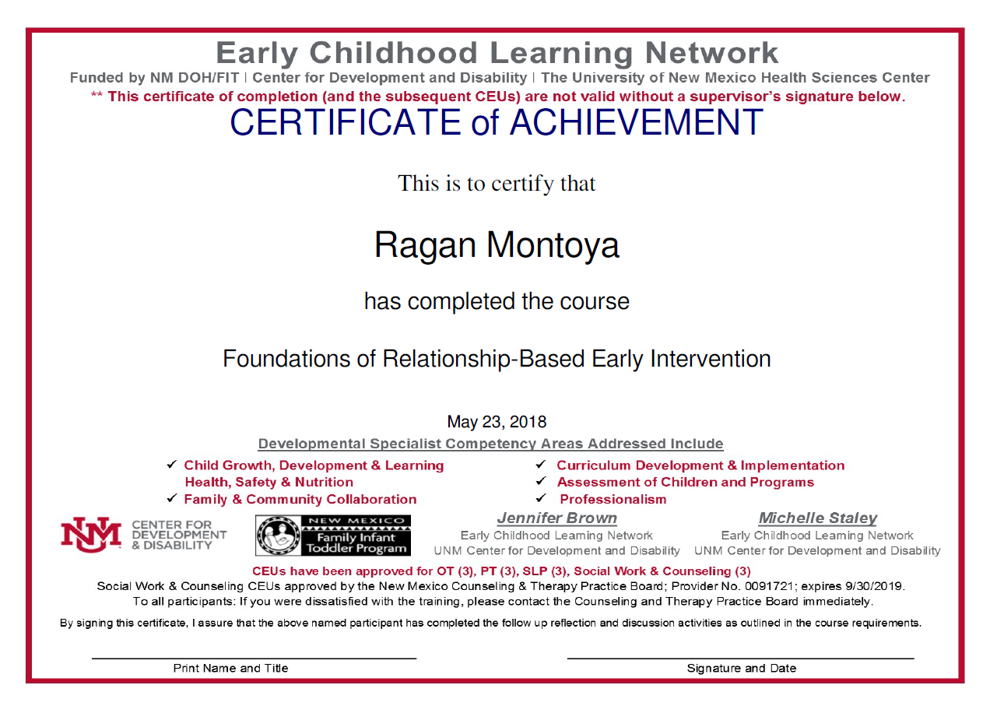
Notes:
Andy
The participant will be able to download their certificate once they complete the final quiz just as they do in other trainings, however the certificate for the “Foundations of Relationship-Based Early Intervention” course will look slightly different than other certificates. Notice the statement, “By signing this certificate, I assure that the above named participant has completed the follow up reflection and discussion activities as outlined in the course requirements.” You will also see space for the supervisor or mentor to print their name, title, provide their signature and the date. This information is needed to validate the certificate.

Slide 16

You are not alone!
Notes:
Andy
You will be supported by your FIT Regional Coordinator and/or your ECN Consultant as your agency moves forward with your Professional Development Leadership Team. We are ready to assist you in exploring how practitioners in your agency will be supported to reflect and consider their ongoing learning through these follow up activities.

Slide 17
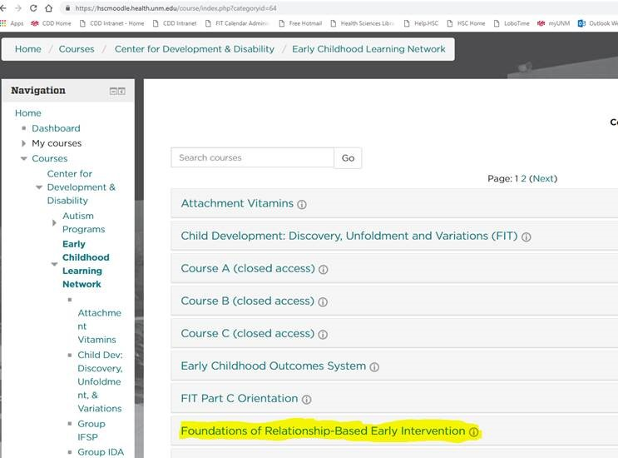
Do you want to access the Online Module?
It can be accessed here:
https://hscmoodle.health.unm.edu/course/index.php?categoryid=64
Click Here
Notes:
If you are interested in accessing the course, you can copy and paste the above link. If you are in slide show mode, simply click the button, then navigate to the Foundations of Relationship-Based Early Intervention tab.

Slide 18

Notes:
If you have any questions, please contact your ECN Consultant and/or FIT Regional Coordinator.

Slide 19

Remember FIT and ECN are just a phone call away!!
Notes:
Thank you for viewing this presentation. To access the Foundations of Relationship-Based Early Intervention Online Training,

