Slide 1
NMSIIS (New Mexico Statewide Immunization Information System)
Kathryn Cruz, NMSIIS Manager
November 14, 2023

Slide 2
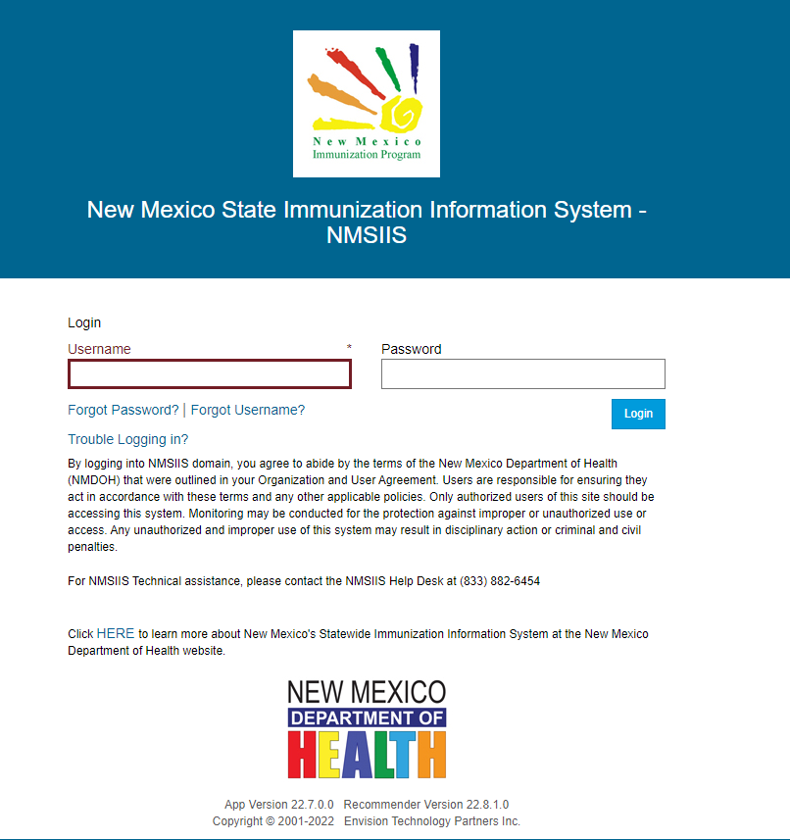
NMSIIS
~2.8 million patient records
~32 million vaccines
1500+ providers in NM
24k+ active users
Mandatory reporting of all vaccine doses administered in NM (Senate Bill 58) regardless of vaccine type or patient age
Benefits of an IIS:
Centralized records
Inventory management
Reporting
Outbreak response
Reminder/recall

Slide 3
Access to NMSIIS
Who can access NMSIIS?
Healthcare providers and staff
Schools (nurses, administrators)
Managed Care Organizations (MCOs)
Additional Public Health Entities
What are the types of NMSIIS access?
Read Only (view patient records/demographics, run reports)
Basic User (edit access, report vaccines, run reports)
Inventory Control (order, maintain and reconcile vaccines)
Where can I ask questions about accessing NMSIIS?
NMSIIS.Access@doh.nm.gov

Slide 4
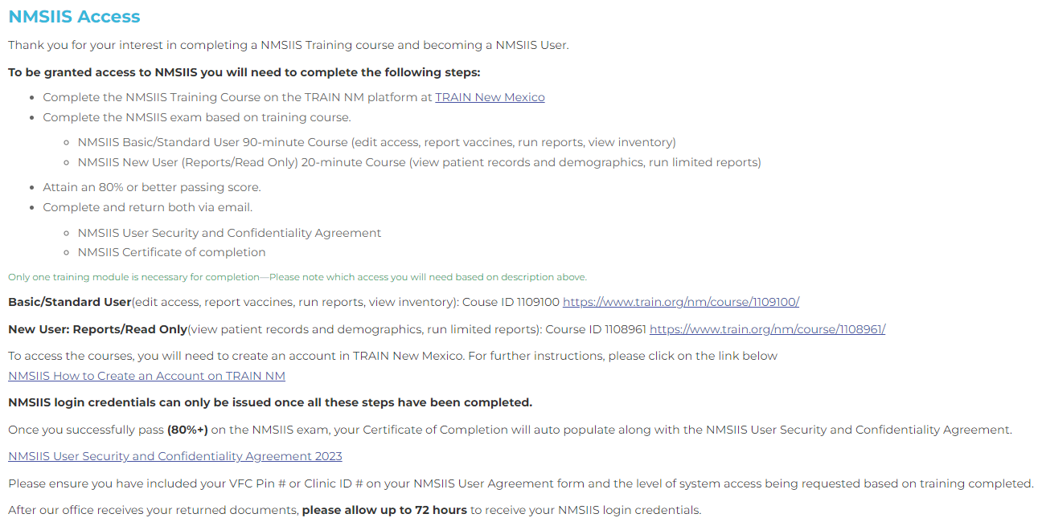
NMSIIS Training Website (https://www.nmhealth.org/about/phd/idb/imp/siis/train/ )

Slide 5
NMSIIS Agreements
Organization Agreement – required for newly onboarded locations, clinics or providers to NMSIIS or name/address changes of existing locations or clinics
User Agreement – required for all users of the NMSIIS registry, regardless of their access level
Must be current year
Must be complete
Must be legible
Must be signed

Slide 6
Reporting to NMSIIS
Required reporting for all provider types that administer vaccines, regardless of vaccine type or patient age, per Senate Bill 58
Exception for federal entities, such as VHA or IHS
Barriers: lack of resources, lack of education and/or reporting under alternate pin numbers
Options for NMSIIS Reporting
Manual Entry
Data is entered directly into NMSIIS by clinic staff for patient demographic and vaccination information
Automated Data Exchange
Data is entered into provider Electronic Health Record (EHR) System and crosses via automated data exchange to NMSIIS

Slide 7
NMSIIS Reporting
Patient Data
Last Name
First Name
Middle Name
Gender
Date of Birth
Insurance Status
Mailing Address
Physical Address
Phone Number/Email
Race
Ethnicity
Vaccine Data
Vaccine Name
Manufacturer
Lot/Serial Number
Funding Source
Expiration Date
NDC
Date of Administration
Dosage
Body Site
Body Route
Timelines
Routine Vaccines (including COVID):
10 Days
Mass Events:
30 Days

Slide 8
Data Quality in NMSIIS

Slide 9
Data Quality Components
COMPLETE:
Patient Address
Race/Ethnicity
Gender
Phone Number or Email Address
Vaccination Data
TIMELY:
Routine: 10 Days
COVID-19: 24 Hours
Mass Events: 30 Days
VALID:
1900 or 1901 DOB
Baby names
Vaccine Date after Expiration Date
Vaccine Date before DOB
Incorrect Vaccine Type for Age Group

Slide 10
Incentives for Clean Data
State mandate – Senate Bill 58
Federal mandate for
COVID-19 vaccines
Coverage Rates
Continued vaccine provided by VFC program
Public Requests
Healthier New Mexico!

Slide 11
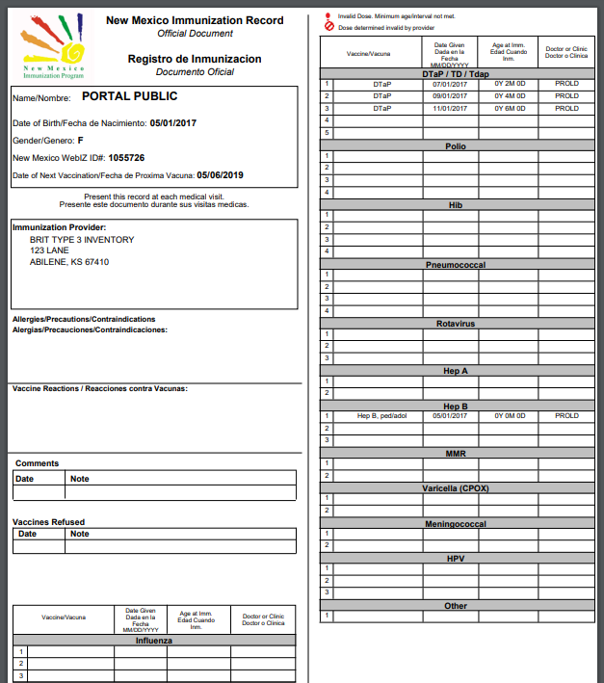
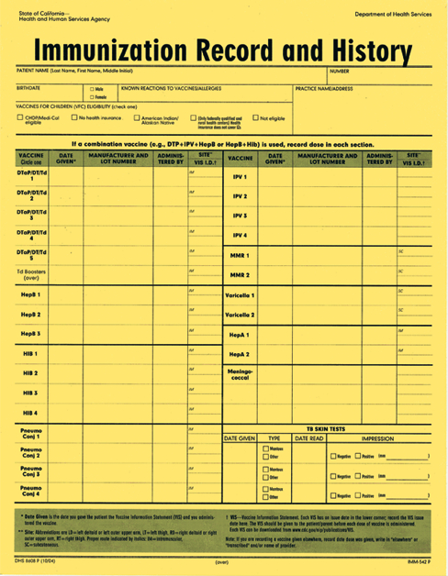
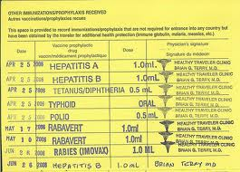
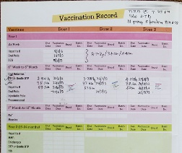
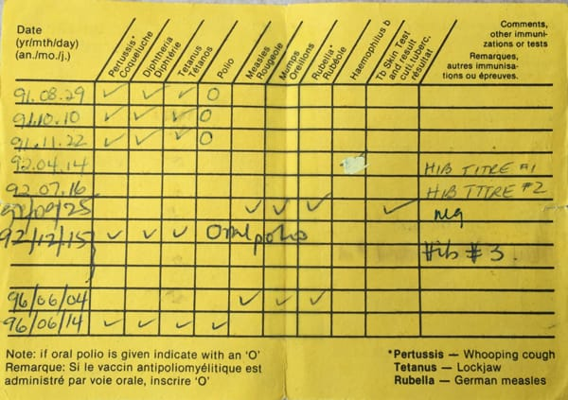
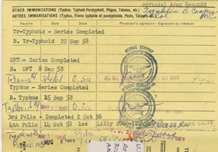
VaxViewNM Consumer Public Portal
The New Mexico Statewide Immunization Information System VaxViewNM enables individuals, parents, and guardians to access, save and/or print, official immunization records. Eliminating the need to carry multiple or aged documents.

Slide 12
Security
The security and protection of patient records is our highest priority.
The web-based application is mobile friendly.
An exact 1:1 match to data fields is required.
The two-factor authentication utilizes text messaging or email to validate patient, parent, or guardian access.

Slide 13
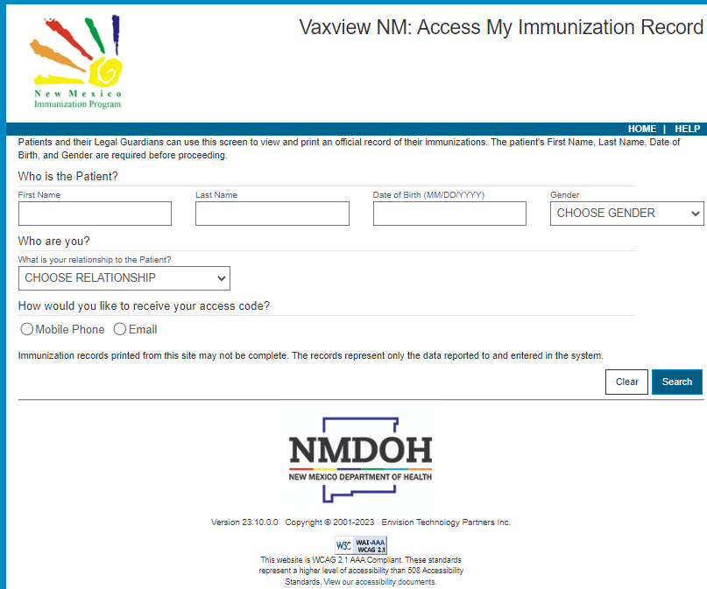
Critical Information
There are several elements that are critical to locating and authenticating both the user and the patient.
First name, Last Name, DOB and Gender
Relationship to Patient
Phone Number or Email Address
Note: Parents, guardians and patients will not be able to access records, if one or more of these elements are not present or correct.

Slide 14
Troubleshooting
Information entered into VaxViewNM must match NMSIIS exactly or no record will be found!
2. The message stating a record wasn't found does not mean the record isn’t in NMSIIS – only that the data in NMSIIS didn’t match the data input on the search screen
3. Phone # and email must be populated in Demographics screen and Contacts screen
4. Three unsuccessful attempts from the same IP address will lock the user out for 30 minutes

Slide 15
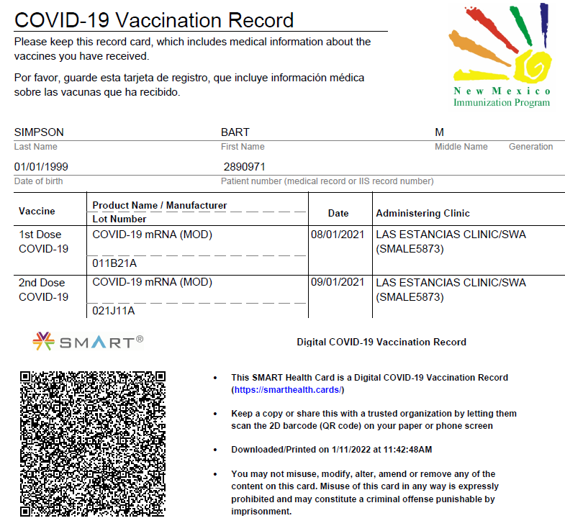
QR Code on Digital COVID-19 Vaccine Card
SMART Health Cards are paper or digital versions of your clinical information, such as vaccination history or test results. They allow you to keep a copy of your records on hand and easily share this information with others if you choose.

Slide 17
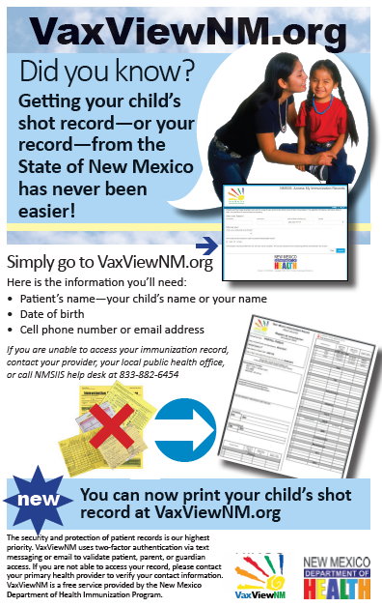
VaxViewNM Materials
Posters for providers
Flyers to be handed out
Incentive items (magnets, stickers, pens, notebooks, tote bags, phone holders)
To request items, please contact Kathryn Cruz or NMSIIS Help Desk

Slide 18
Contact Us
NMSIIS Help Desk (833) 882-6454
Kathryn Cruz Kathryn.Cruz@doh.nm.gov
NMSIIS Manager
COVID-19 Vaccine Email Covid.Vaccines@doh.nm.gov
NMSIIS Email NMSIIS.Access@doh.nm.gov
NMSIIS/Immunization Program Website
https://www.nmhealth.org/about/phd/idb/imp/siis/

